Slide 1
Drive of Nodes/ Hybrid Nodes

Slide 2
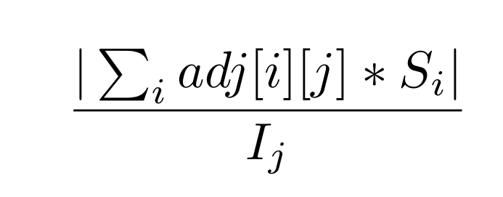
Drive ( Formerly, NormIncan)
It quantifies how much “effective” regulation a node is under at a certain time step. It is defined as follows for J’th node. Here I_{j} is the indegree of the node and S_{i} is the state of I’th node at the time step considered.

Slide 3
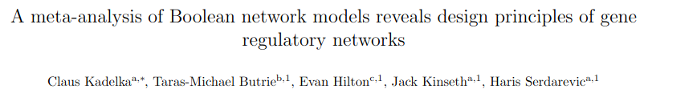
“Hybrid” nodes found in other networks with high team strength (> 0.2) from the given paper

Slide 4
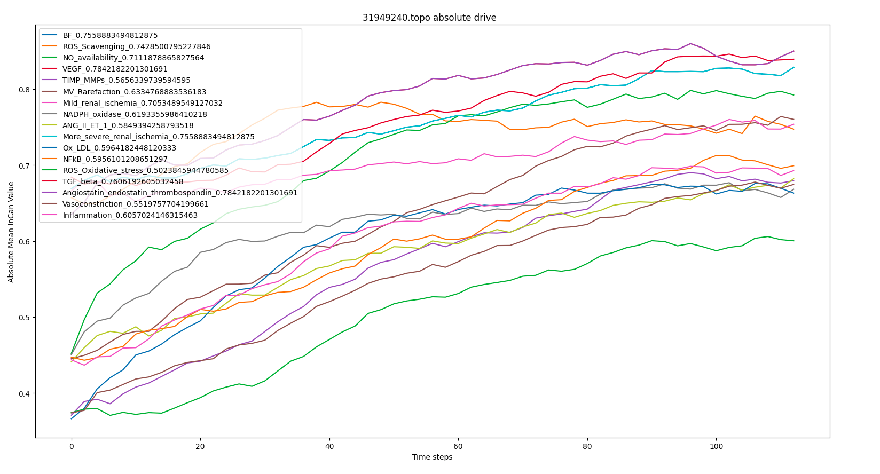

Slide 5
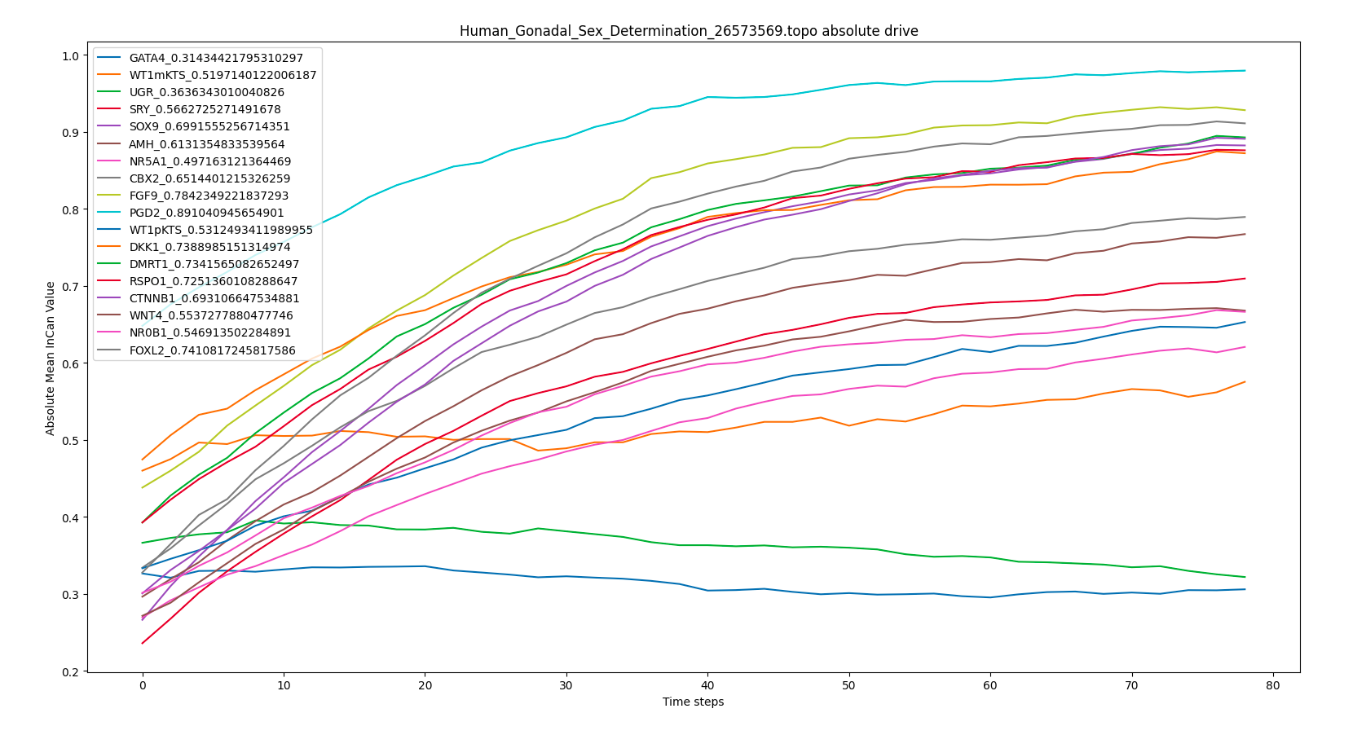

Slide 6
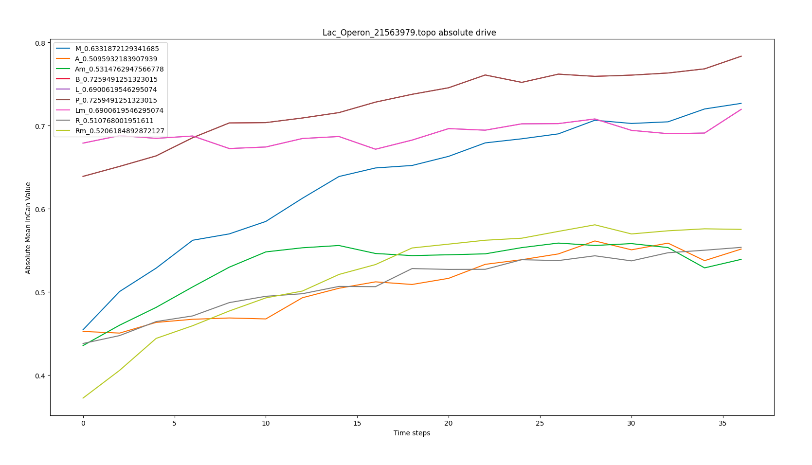

Slide 7
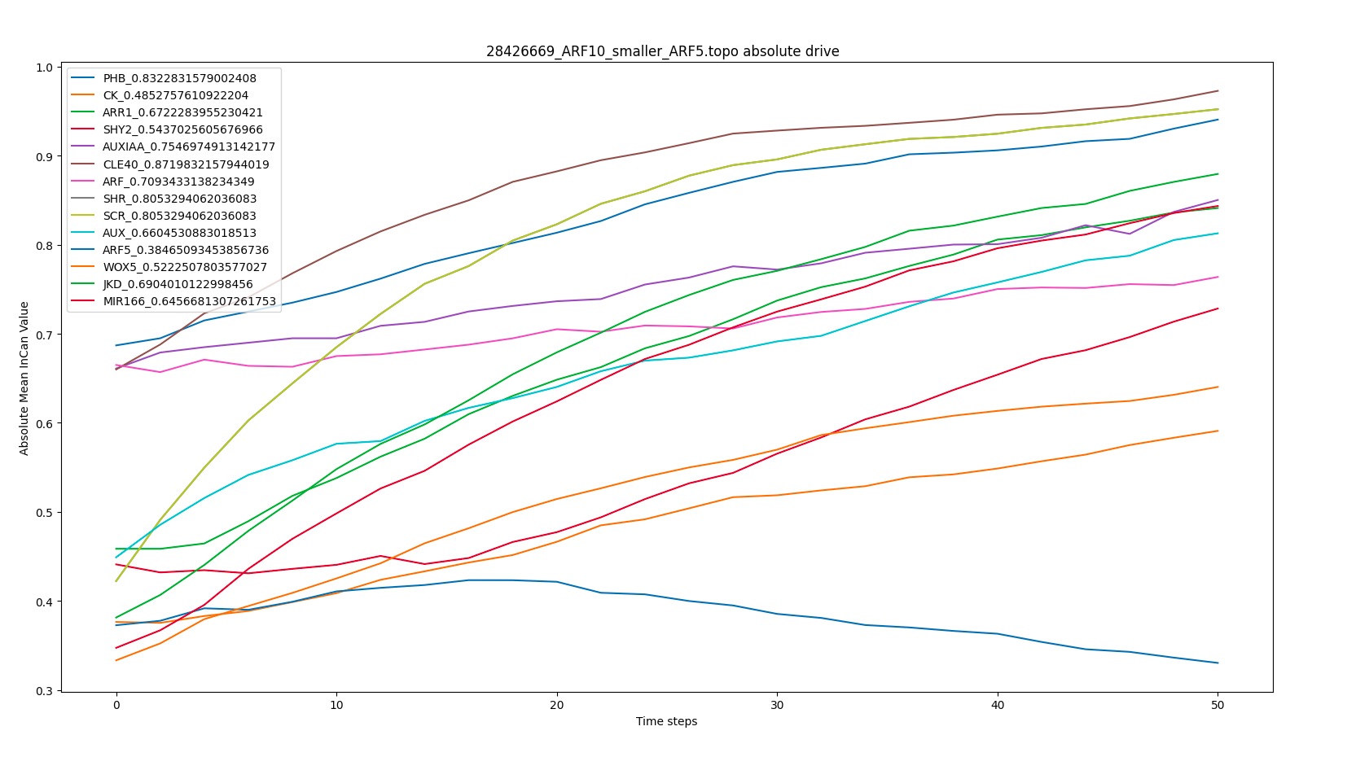

Slide 8
Pure artificial networks do not have any hybrid nodes

Slide 9
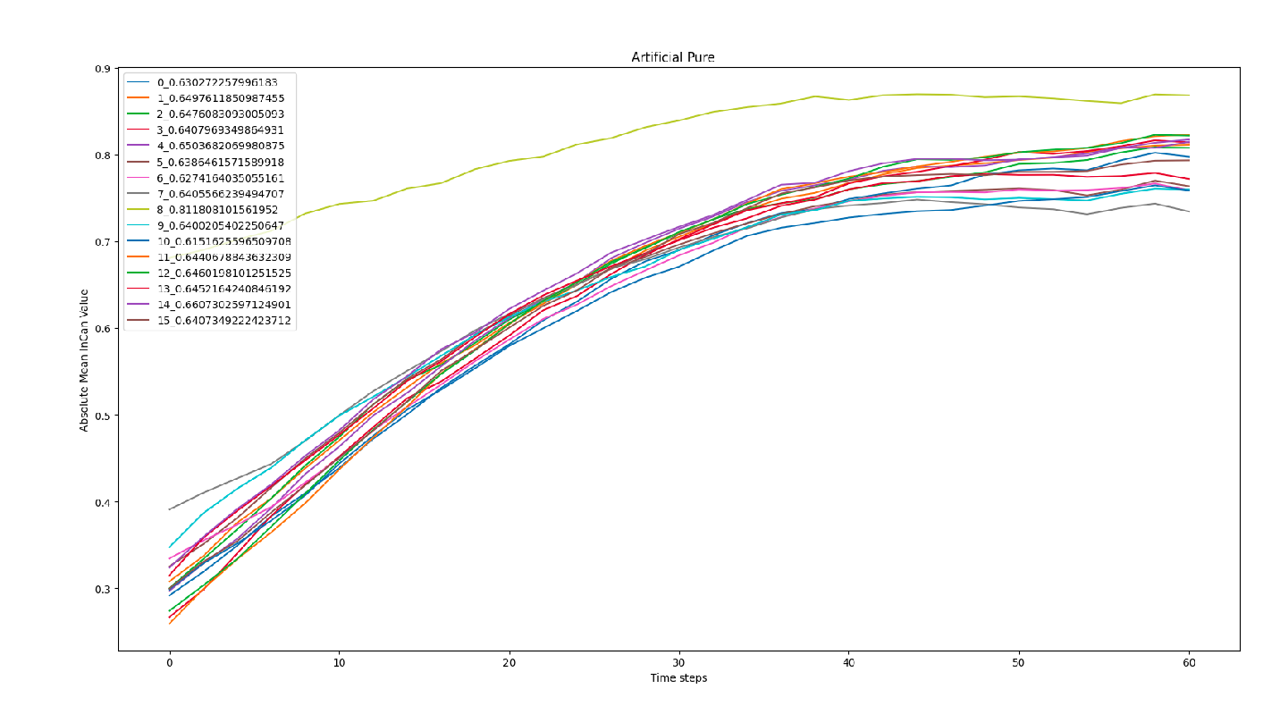

Slide 10
Impure artificial networks have hybrid nodes
On adding a few impurities I could see some hybrid and inconsistent nodes.

Slide 11
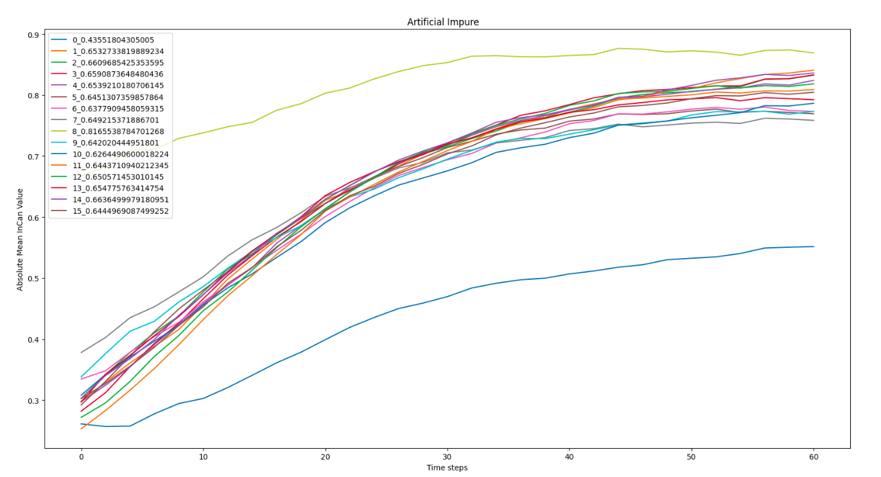

Slide 12
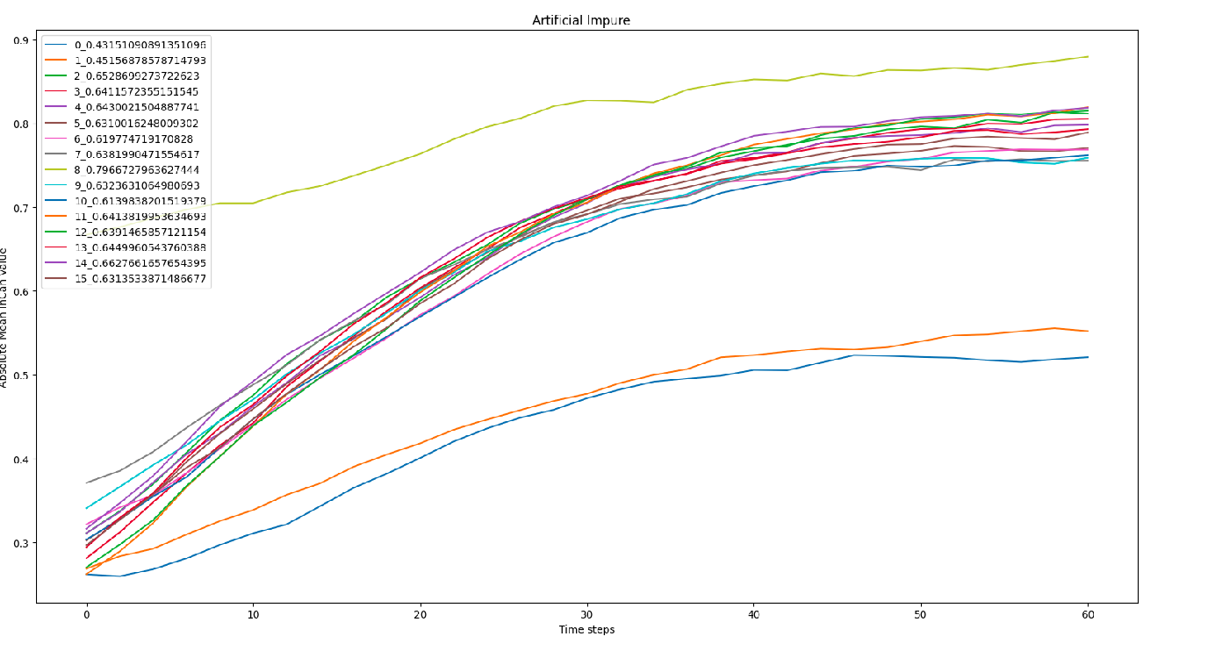

Slide 13
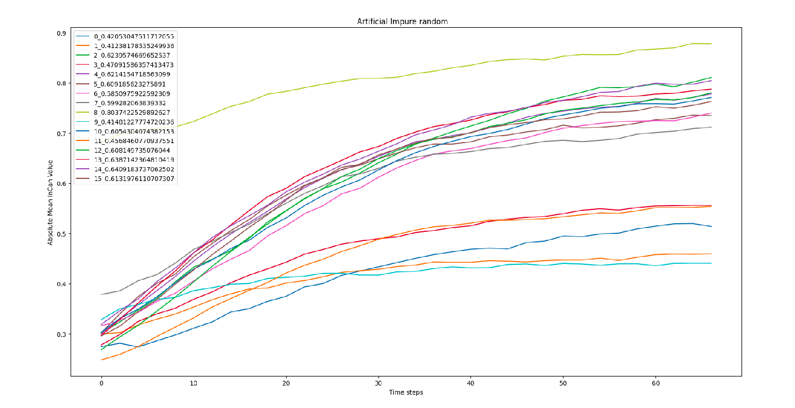

Slide 14
Upon conversion of impure edges to pure edges in biological networks we see that hybrid nodes disappear

Slide 15
Impure/Wild type

Slide 16
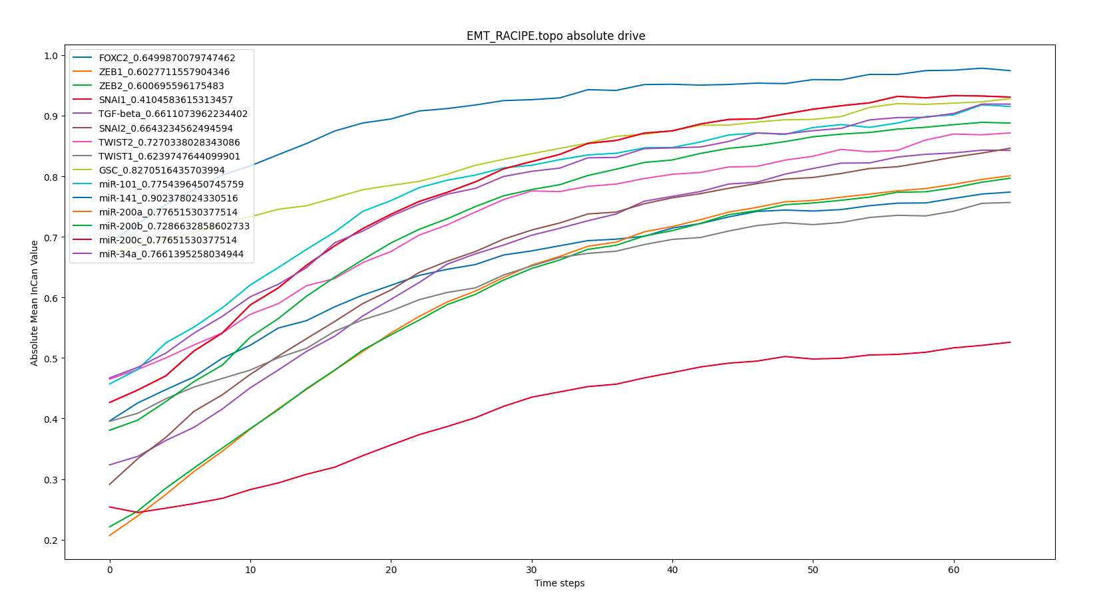

Slide 17
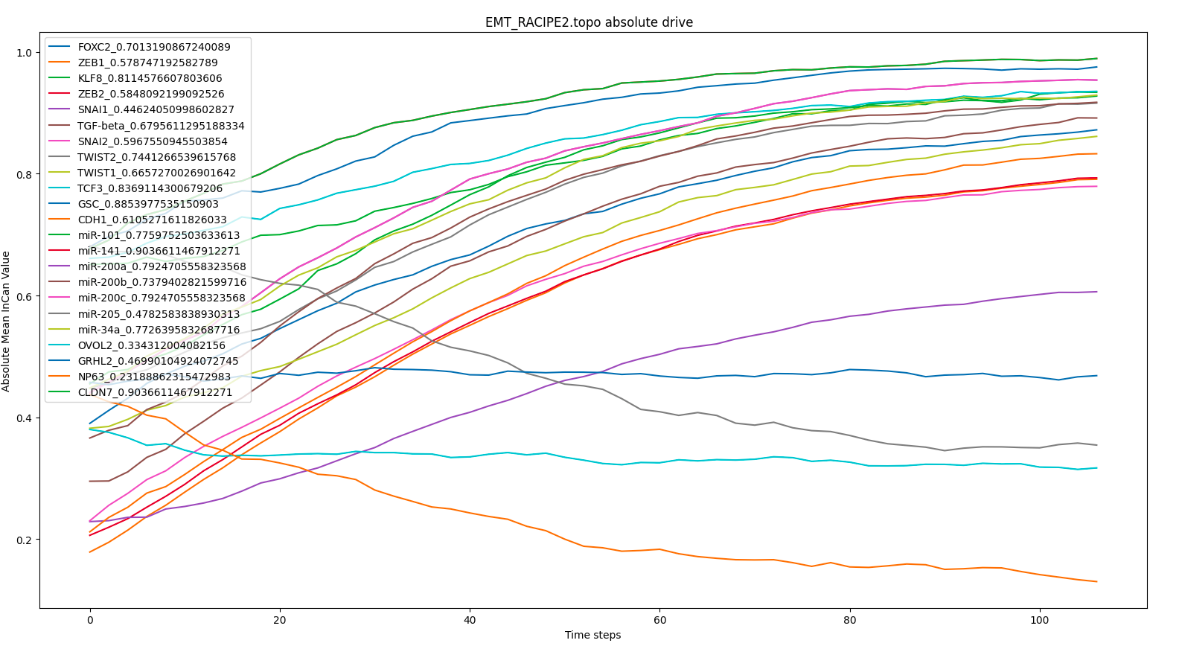

Slide 18
“Purified”

Slide 19
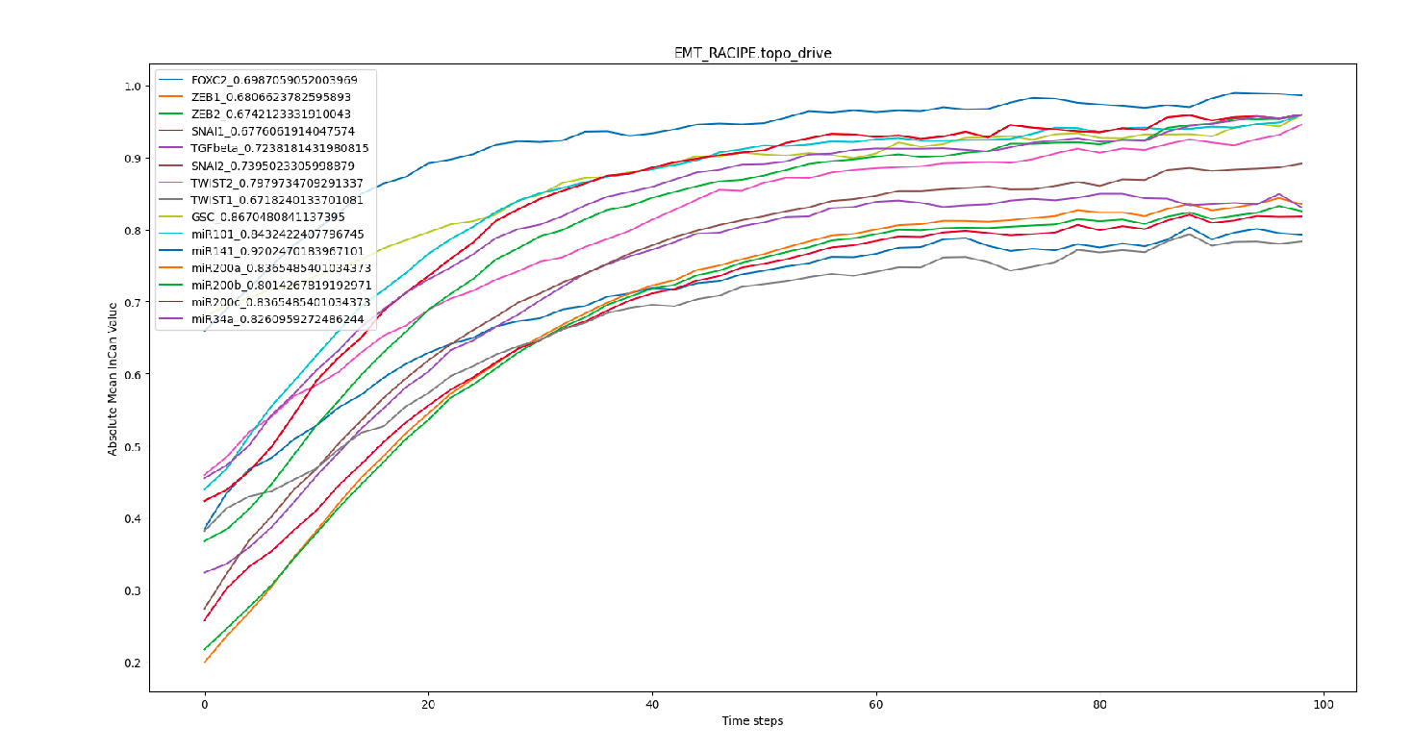

Slide 20
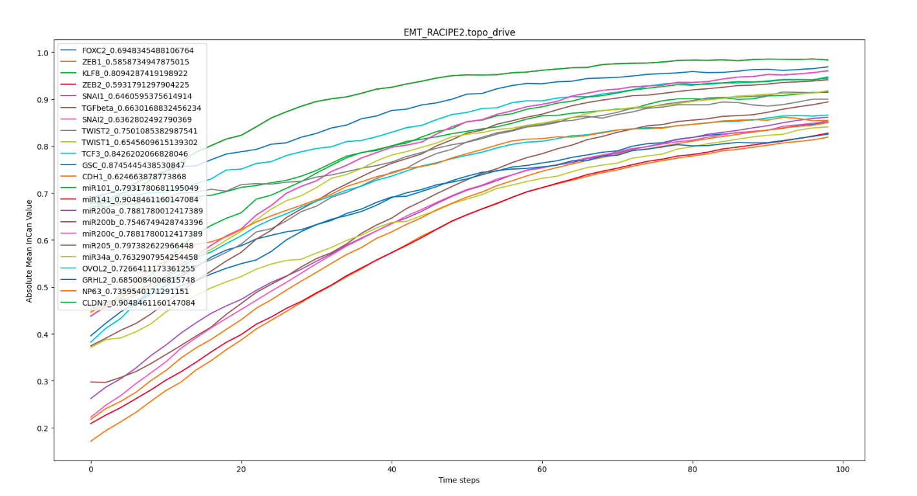

Slide 21
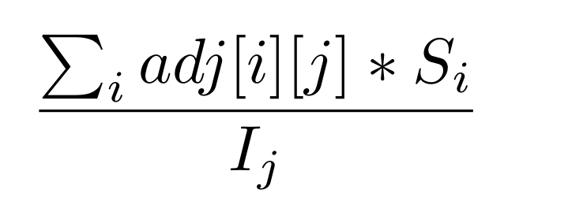
Non absolute drive? Hard to paint a coherent picture.

Slide 22
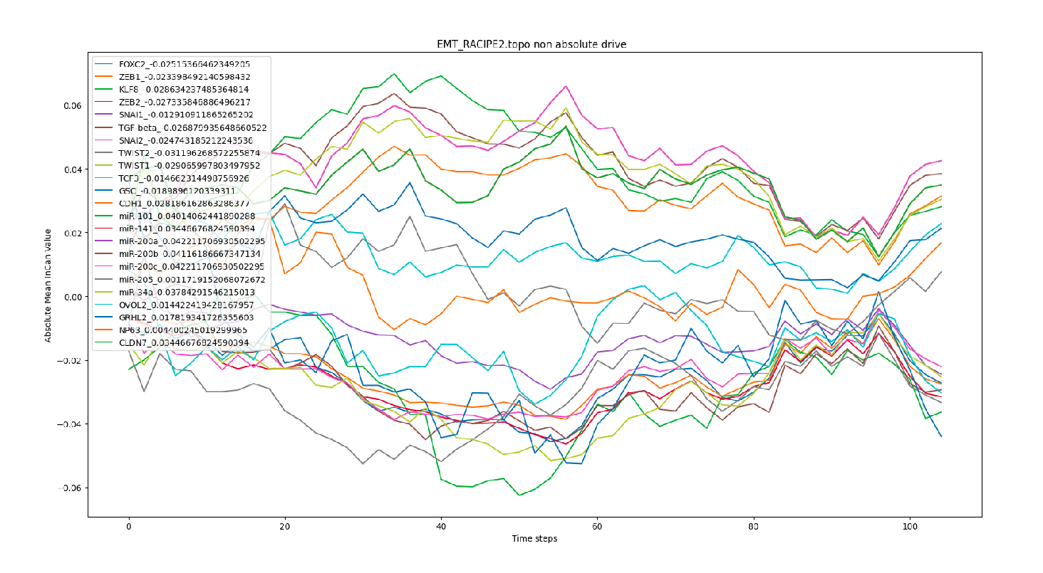

Slide 23
